Slide 1
Project
on
Library Management System
(Database Management System)

Slide 2
Technologies used:
-> Backend:
(1) Mysql for database
(2) Php for connection
(3) Hosting using Xamp server
(4) Ajax
-> Front-end:
(1) Html/CSS for designing.
(2) JavaScript
-> Other:
(1) Powerpoint ppt
(2) Star uml
(3) Notepad++

Slide 3
Basic Features:
-> Functional Requirements for Members
Login
Check the book availability
Search the books
View issued books
Change of password
-> Functional Requirements for Library staff
Issue book,
Receive book
Check status of members

Slide 4
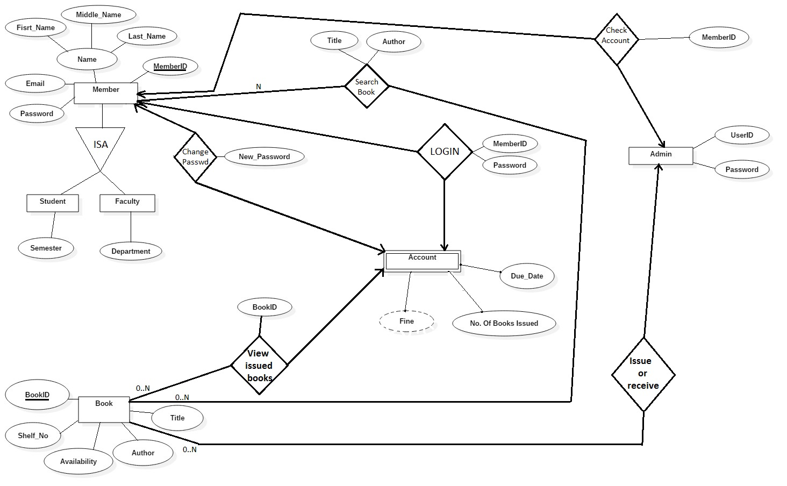

Slide 5
Database Construction:
Tables have been constructed using the procedure of Normalisation:
1 - NF form
2 - NF form
3 - NF form
BCNF form

Slide 6
Tables Before Normalisation :

Slide 7
Member Table :
Mem id | First name | Middle name | Last name | password | Email id | Book id | Shelf no.

Slide 8
Book Table :
Book id | Title | Author | Availability | Shelf no.

Slide 9
Tables After 1- NF form :

Slide 10
Member Table :
Mem id | Name | Password | Email | Book id | Shelf No. | Issued date

Slide 11
Book Table :
Book id | Title | Author | Availability | Shelf no.

Slide 12
Tables After 2- NF form :

Slide 13
Member Table :
Mem id | Name | Password | Email id

Slide 14
Book Table :
Book id | Title | Author | Availability | Shelf no.

Slide 15
Issued_By Table : -
Mem id | Book id | Due date

Slide 16
Tables After 3- NF form :

Slide 17
Member Table :
Mem id | Name | Password | Email id

Slide 18
Issued_By Table : -
Mem id | Book id | Issue date

Slide 19
Book Table : -
Book id | Availibility | Shelf No. | Title

Slide 20
Book_detail Table : -
Title | Author

Slide 21
Details of the Website Created

Slide 22
Home Page :

Slide 23
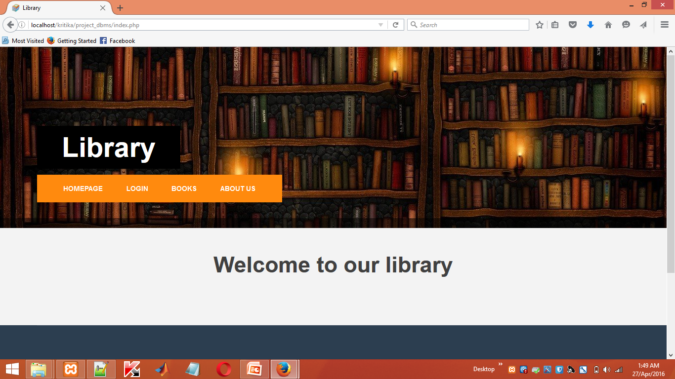

Slide 24
Login Form :

Slide 25
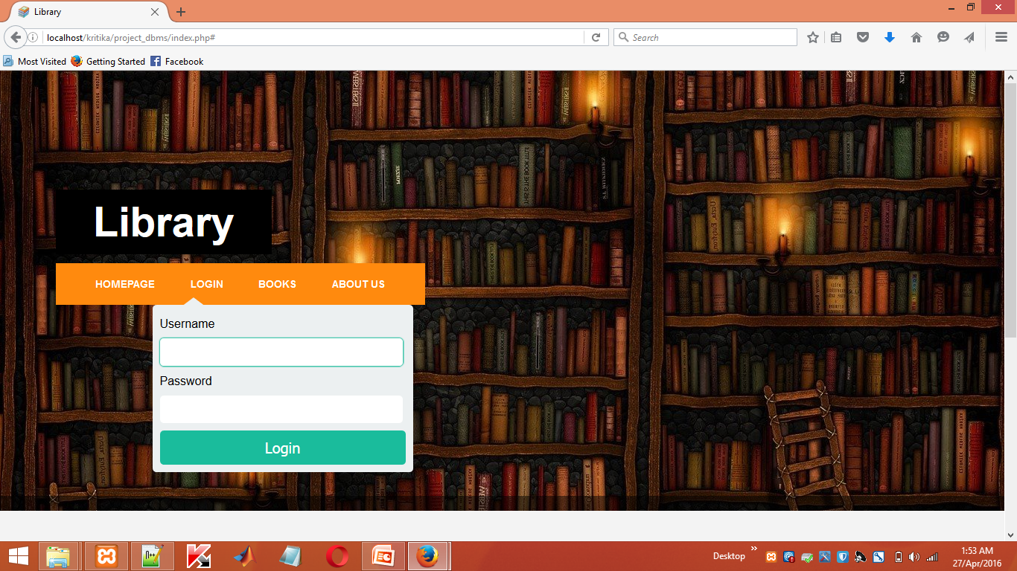

Slide 26
Member Account :

Slide 27
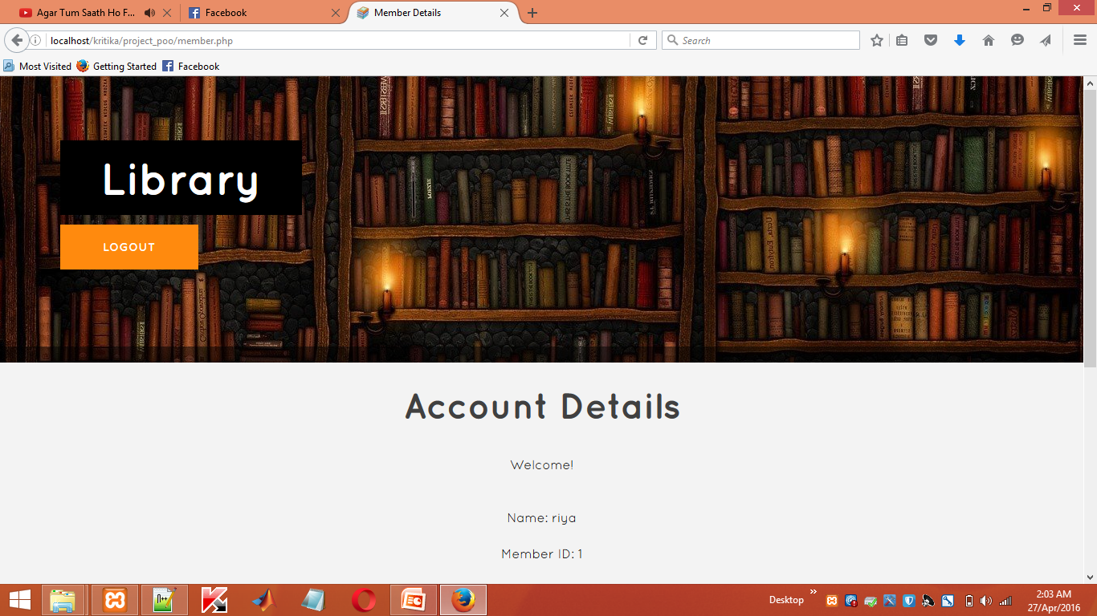

Slide 28
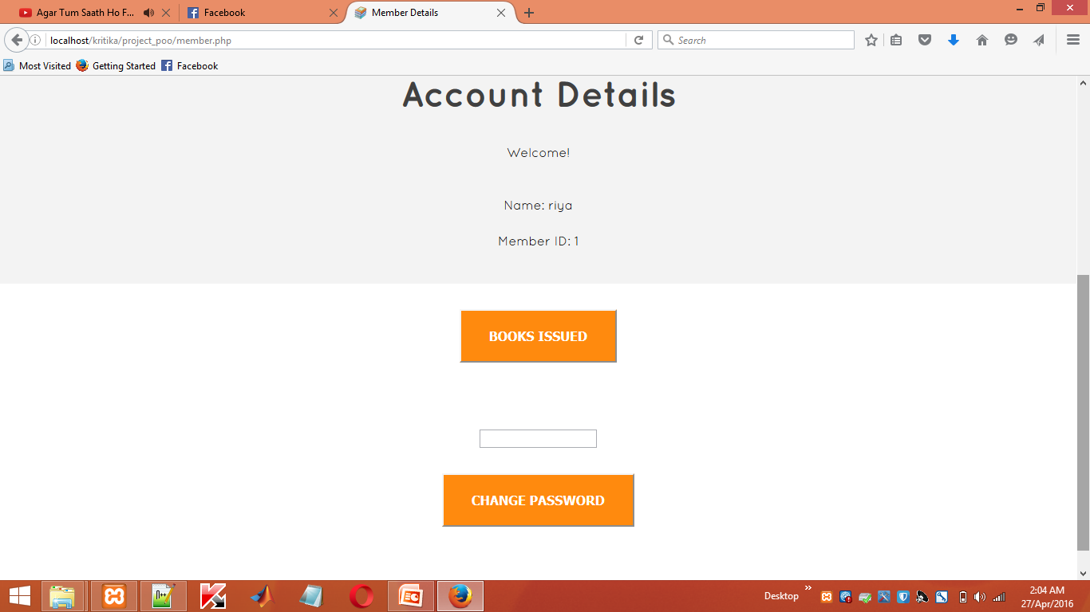

Slide 29
Book Search :

Slide 30
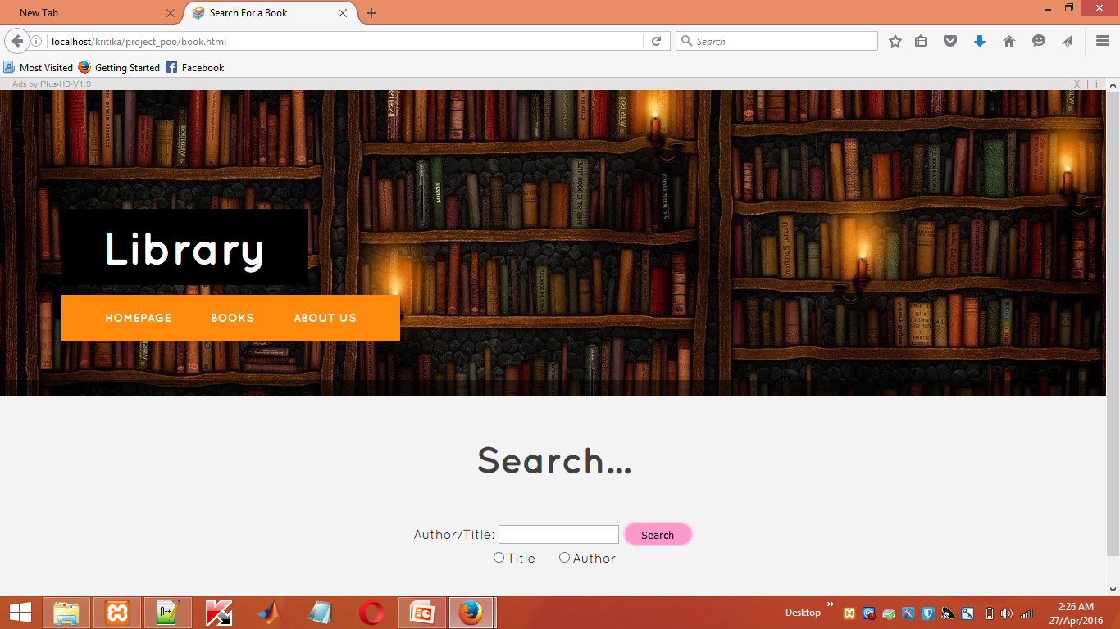

Slide 31
Admin Account :

Slide 32
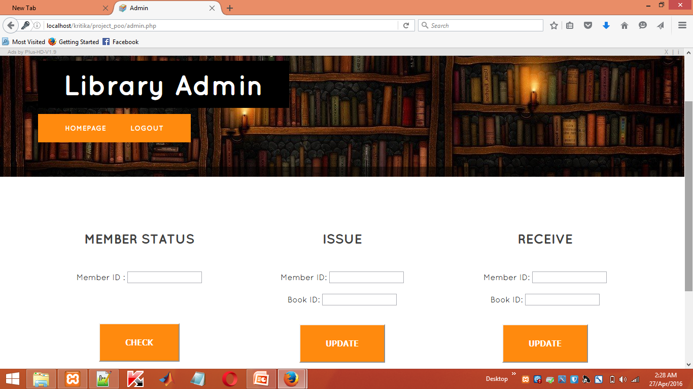

Slide 33
Database in Xampp Server

Slide 34
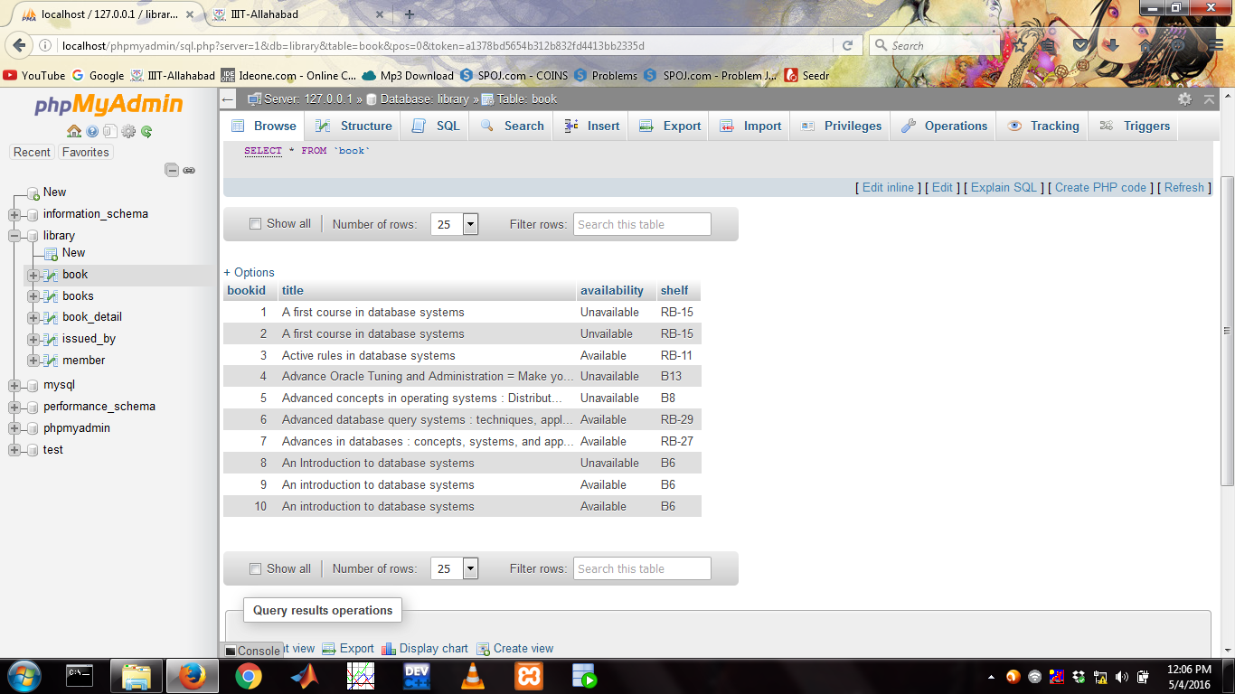
Book Table :

Slide 35
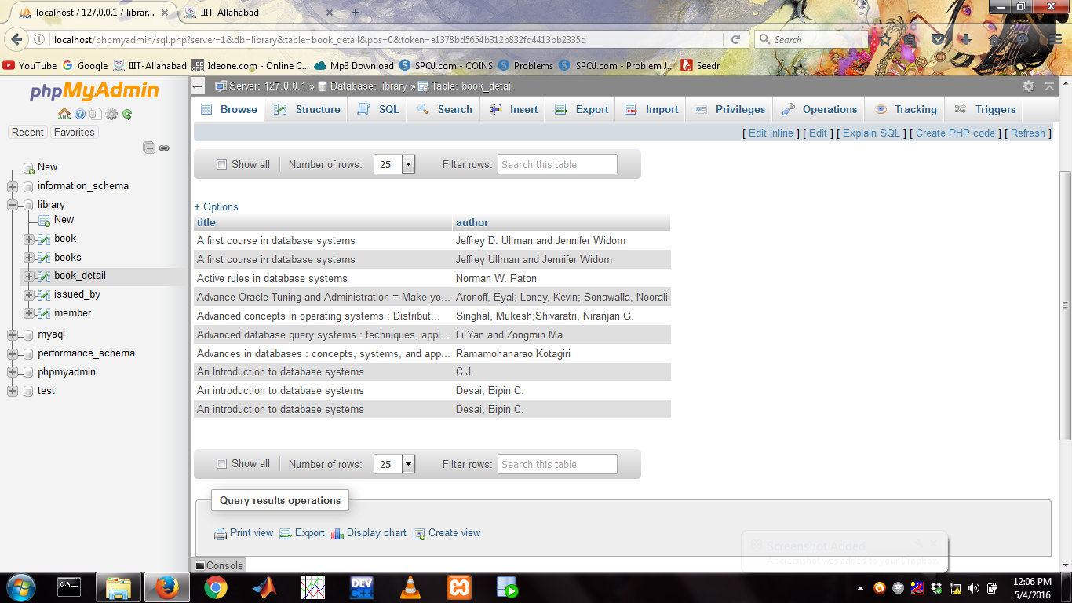
Book_detail table:

Slide 36
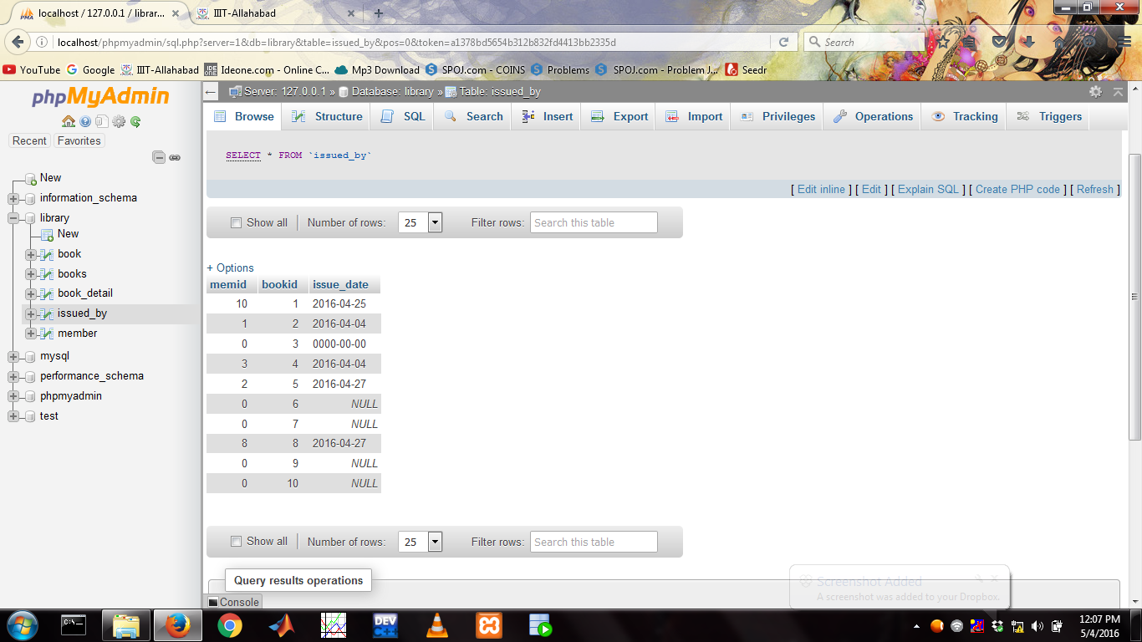
Issued_by table:

Slide 37
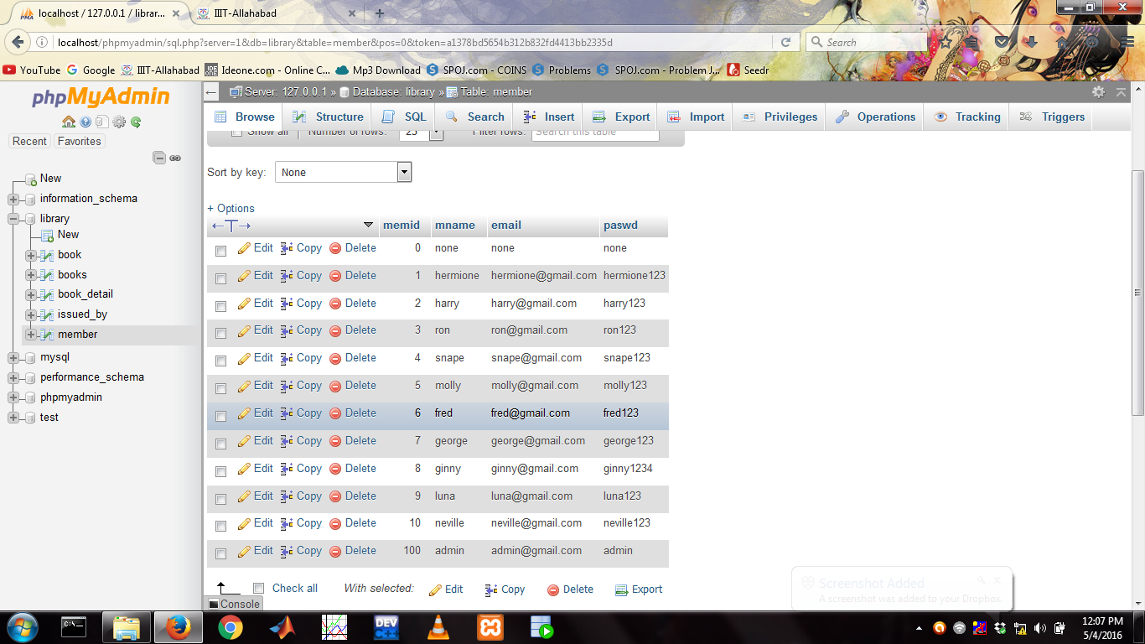
Member:

Slide 38
Thank You…

